Slide 1


Using Machine Learning for Anomaly Detection
Ryan Park
Computer Systems Lab
2023-2024
1

Slide 2
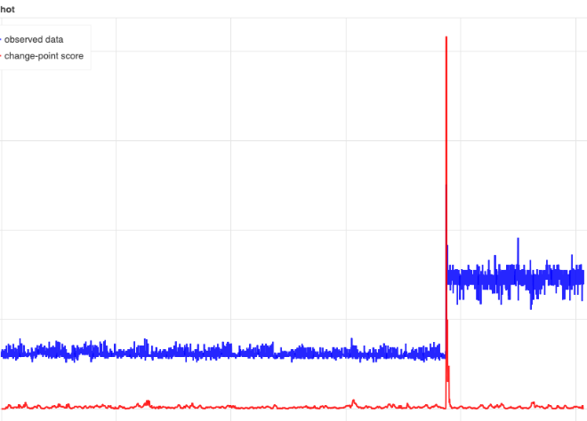
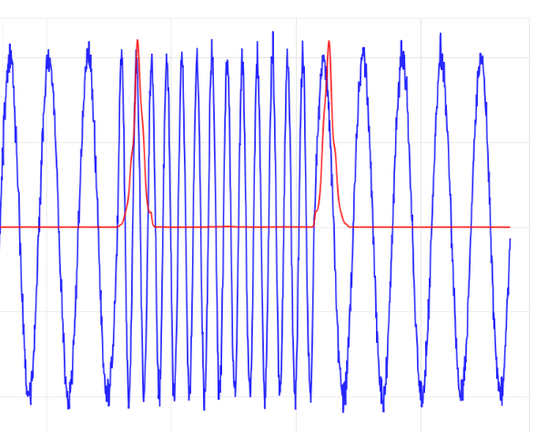
Anomalies
Contextual Outliers: specific point that is anomalous within specific context
Collective Outliers: collection of data points that is anomalous compared to rest of data
2
Notes:
Point anomalies are outliers and are easily identifiable
Contextual anomalies, like the name suggests, relies on past data and patterns to determine whether or not the current segment of time is an anomaly. Currently there is only one signal and the anomalous points are clearly labeled in red, but, when there are multiple variables and there is no indication of where anomalous behaviors occurs, then manual identification gets a lot more complex.
The Frog Boiling experiment is a good anecdote to refer to. To those unfamiliar, it is said that a frog put in boiling water will immediately jump out. However, if the frog is put in a vat of room-temperature water and the temperature is slowly increased, the frog will not notice the change. This is directly applied to how point anomalies are easily identifiable, but contextual anomalies may occur gradually over time and manual identification may not be precise or accurate enough.
What happens if you have a long term anomaly (frog is on a longer time scale than the rest)

Slide 3
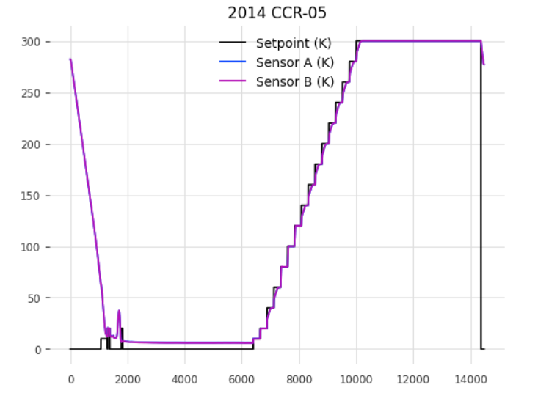
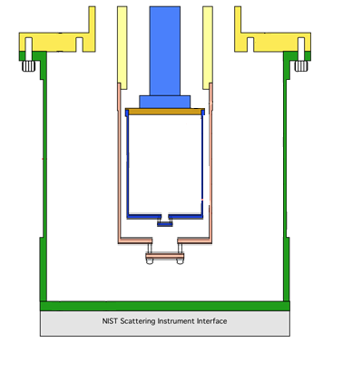
Problem
Closed Cycle Refrigerator (CCR)
How does it currently work?
Control System
Setpoint
Sensor A, B, C, D
Manual troubleshooting (no notification or pinpoint system)
Sample
2
Notes:
Currently, at the ncnr we have ccr which is responsible for cooling samples down to about -452 degrees Fahrenheit in a neutron beam experiment
In essence, we need to check that the control system is working. When you set the setpoint, the corresponding sensors should follow. This is a bigger problem than people think. People Reserve beam time years in advance, but there are many instances where the temperature controller of the ccr may be broken unexpectedly. Users typically have shorts periods of beam time like 4 days and so experiments are not able to run for them. Furthermore, samples may be very sensitive to temperature fluctuations, making proper execution of the ccr systems critical.

Slide 4
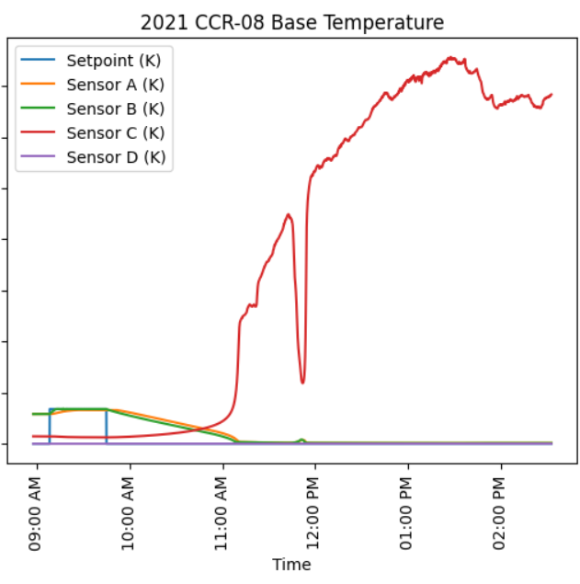
Objective
Build and train a transformer model for sequence prediction
Long Term: Tracks and predicts every available control parameter and sensor across the facility for anomalies
6
Notes:
Fix this graph (sensor a,b,c,d) take out elapsed time and fix dates to be more simple
Train signal to forecast “normal” behavior
This model has an information bottleneck in which we can create a representation of the data (animation

Slide 5
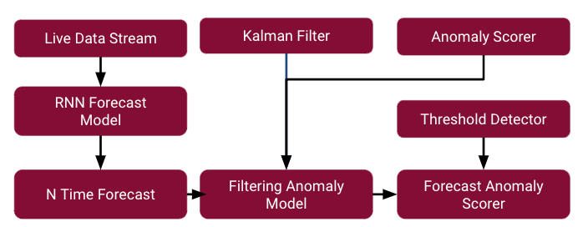
System Summary
10
Notes:
Kalman filter limits noise
Anomaly scorer: mathematical functions that calculates how different original data with forecasted data

Slide 6
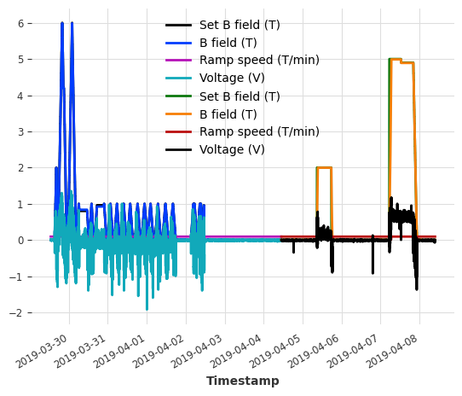
Model Creation
Create CCR dataset, contains experiments spanning past 20 years
Preprocessing
Upsample (30 seconds)
Savitzky-Golay Filter
Which variables should be set as past covariates, future covariates, and targets?
Create a forecasting model that reflects the relationship between Set B field and B field
How does it react with other variables as targets?
10

Slide 7
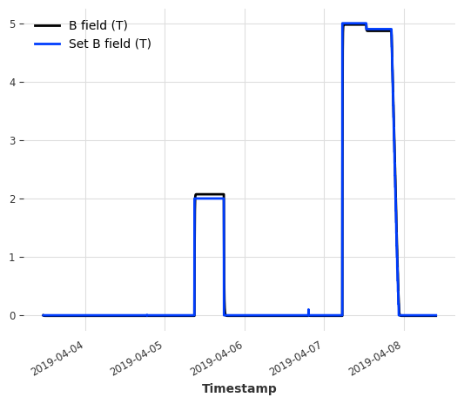
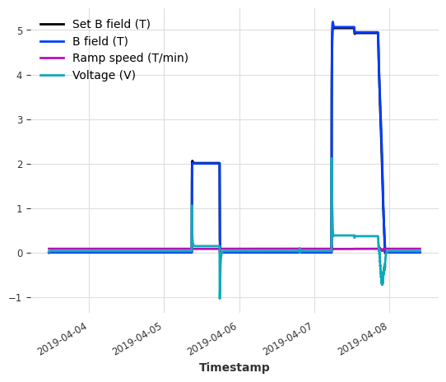
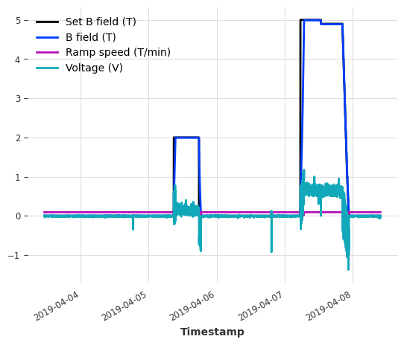
RNN Model
Univariate and Set B field as Future Covariate
Multivariate Target Data with Set B field as Future Covariate

Slide 8

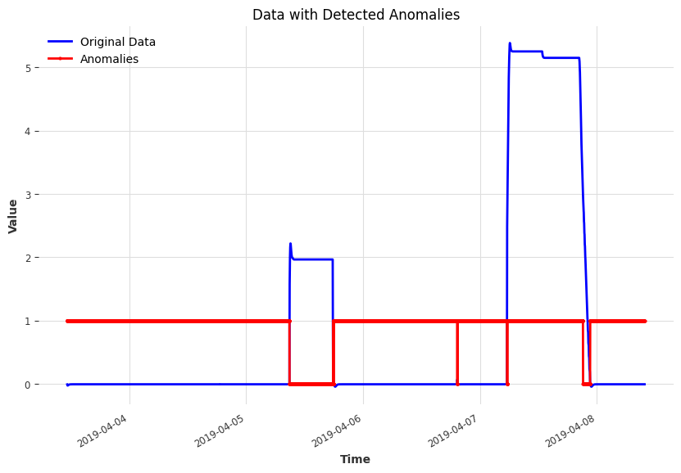
Threshold Detector

Slide 9
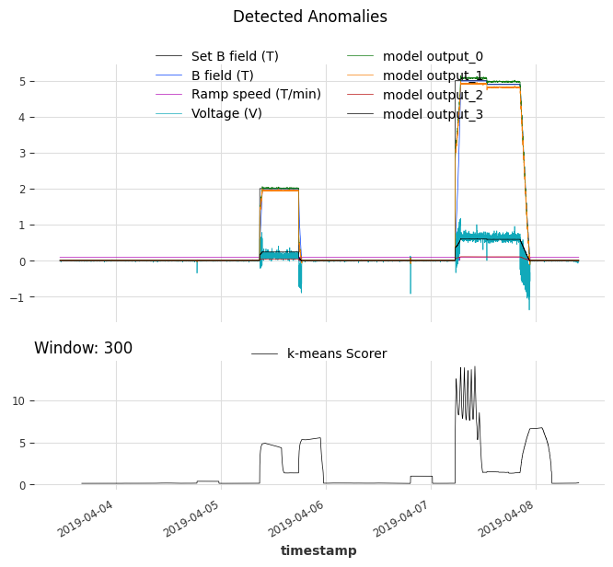
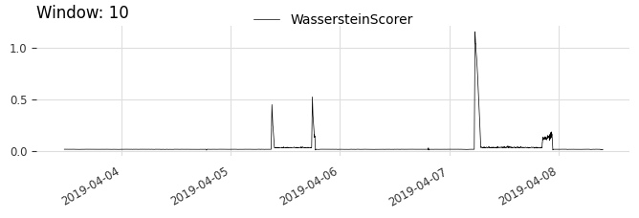
FilteringAnomalyModel
KMeans Scorer
Returns the distance to the closest of the k centroids for each vector of size W
Good for analyzing local patterns in data
Wasserstein Scorer
The Wasserstein distance is computed between the training distribution and each vector, resulting in an anomaly score.
Good for analyzing global patterns in data
Filtering model removes irrelevant data points
Assumes that it can effectively filter the series when anomalies are absent.
Trained on series without anomalies to ensure satisfactory performance.

Slide 10
Future Work
Hyperparameter tuning of Forecast RNN Model and Filtering Anomaly Model
Increasing model accuracy by implementation of more anomaly scorers
Testing with live data from CCR at NCNR
Development of a UI for notification of anomalies

Slide 11
Thank you for listening.
Any questions?

